Slide 1
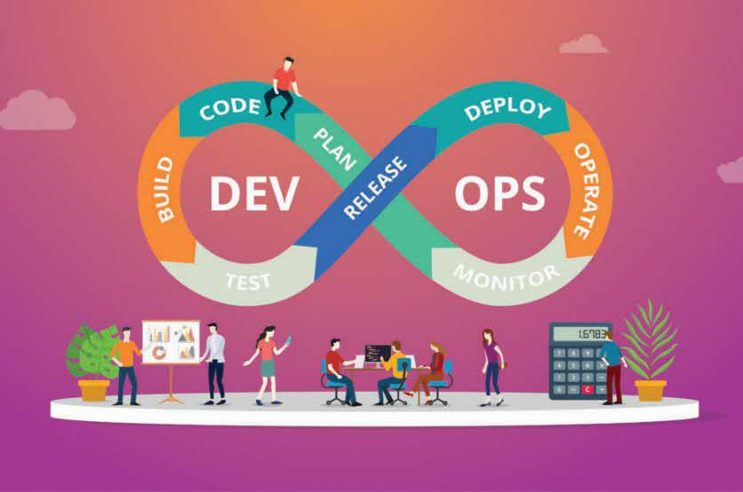
#arkmars
Squad #5
19th March 2021
Members
Arup Sen (398885) - 1
Karuk Sharma (1569687) - 2
Manojkumar Selvaraju (204968) - 3
Razbir Pathania (148232) - 4
Sujay Saboo (392014) - 5

Slide 2
Accomplishments
Created new account and Setup the Environments - Build, Test, Prod Server in AWS & SonarQube in GCP
Setup the accounts in Github, Jfrog Artifactory, Slack, Blaze meter, Pivotal Tracker, Docker hub.
Static Code analysis using SonarQube.
Docker Image creation and deployment for Ubuntu with Postgres and tomcat.
Configured Build server as Ansible controller.
Created repository of code in Git Hub.
Setup Declarative Pipeline using Blue Ocean UI.
Workflow defined with respect to Declarative Pipeline.
Configured VM’s (Build/Test/Prod) using Ansible​.
Deployment to Test & Prod server.
Performed Testing in Test and Prod Environment using Selenium and Blaze meter.
Integrated GIT, Slack and Pivotal Tracker​.
Monitoring using Prometheus/Grafana

Slide 3
Why Declarative Pipeline ?
Flexibility.
More Control.
A domain specific language that simplified many tasks.
Allowed us to insert Groovy code into our pipelines any time.
Portability between cloud Providers.

Slide 4
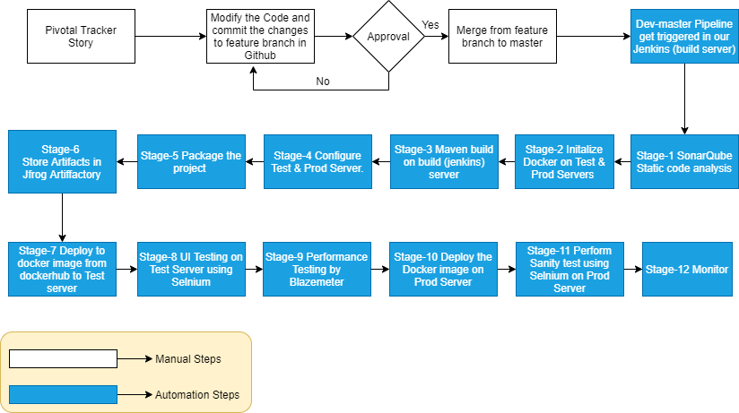
Work flow

Slide 5












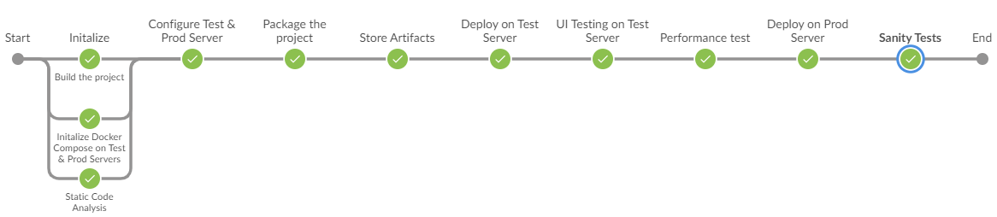
















CI /CD Pipeline

Slide 6
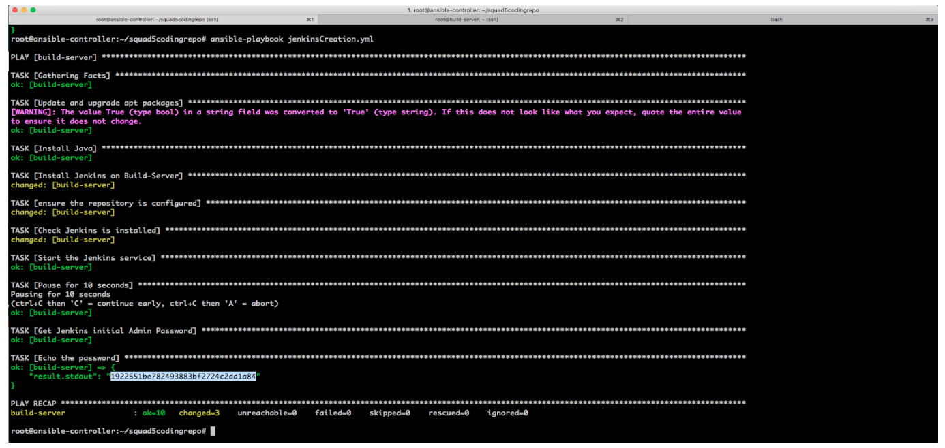
Ansible Playbook Execution

Slide 7
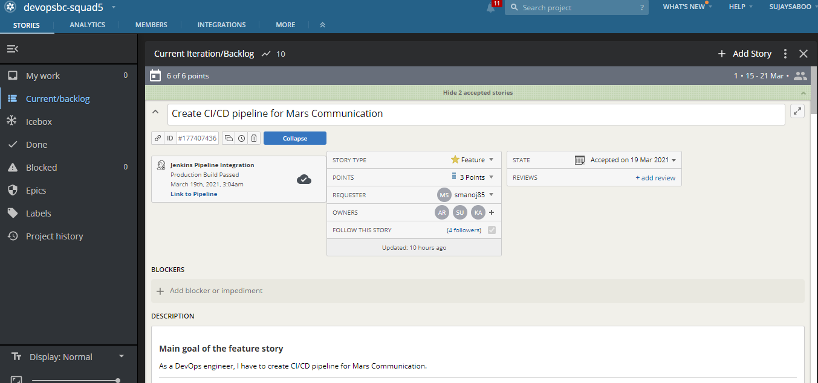
Pivotal Tracker

Slide 8
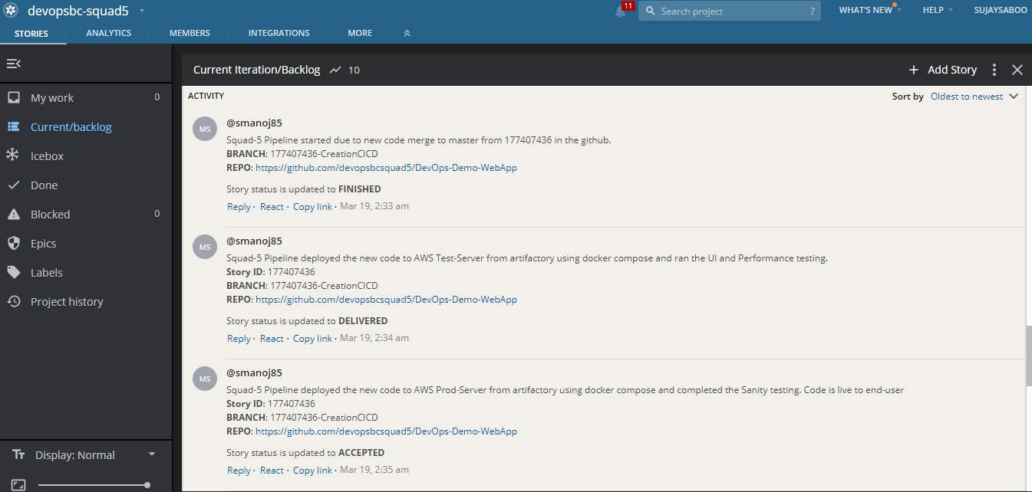
Pivotal Tracker

Slide 9
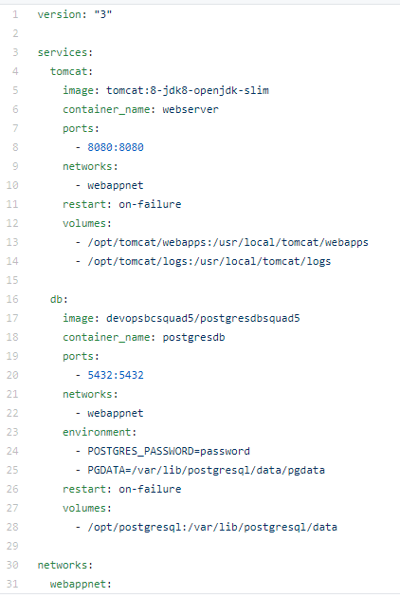
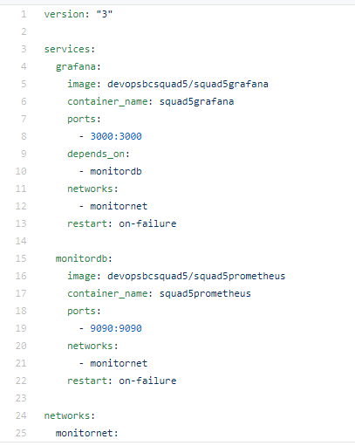
Docker Compose

Slide 10
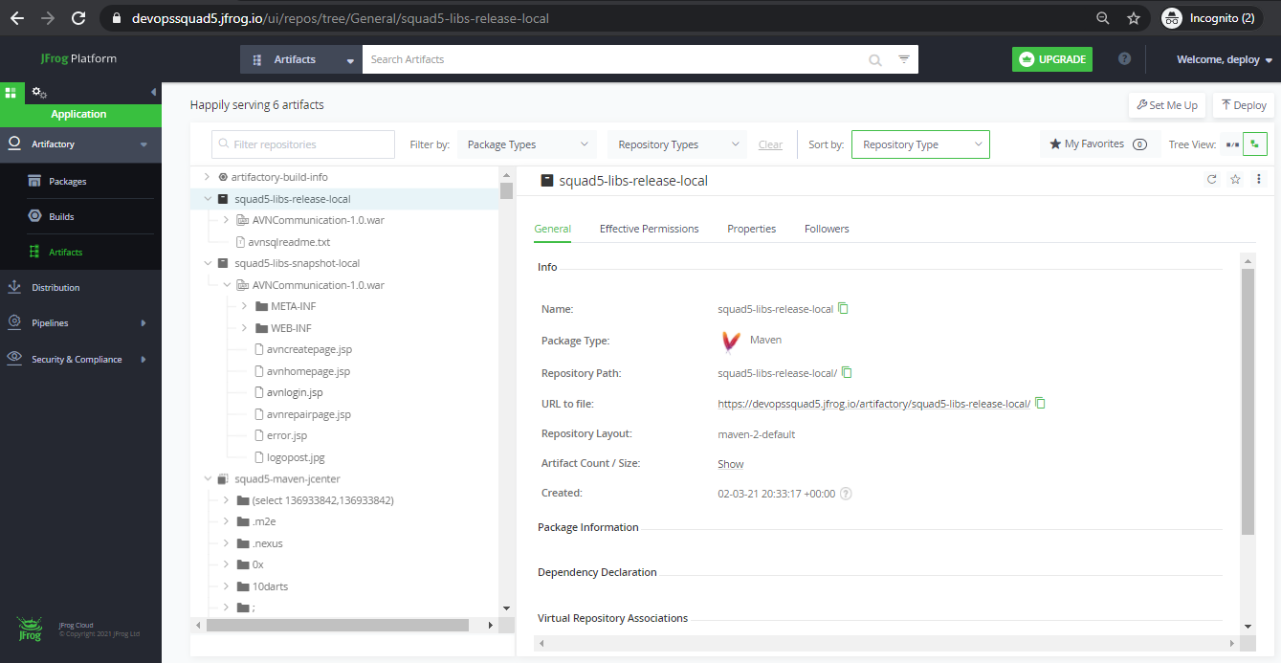
Upload to Artifactory

Slide 11
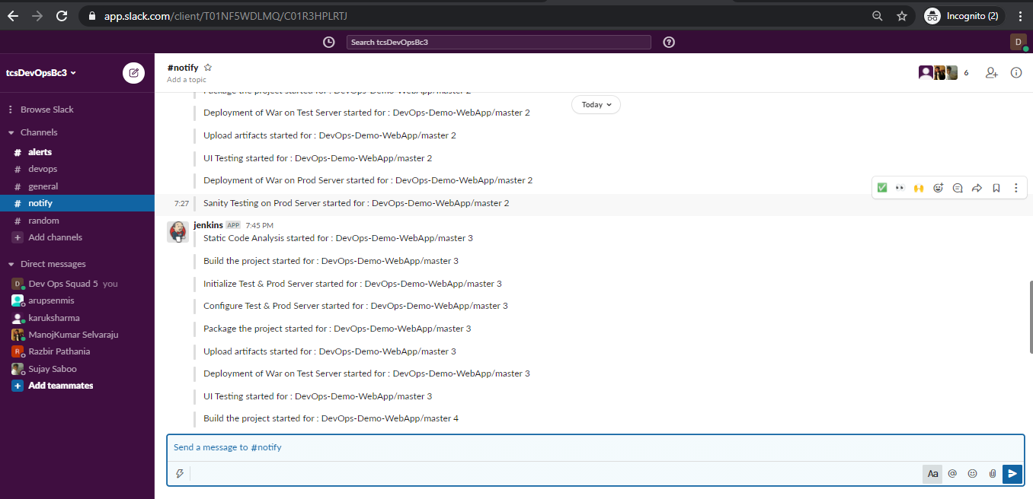
SLACK Notification

Slide 12
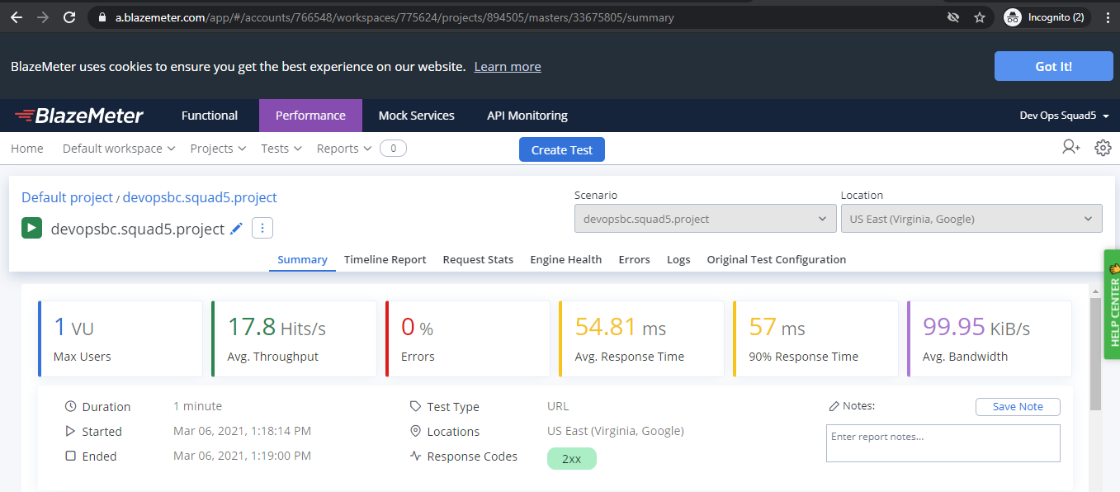
Blazemeter Performance Test

Slide 13
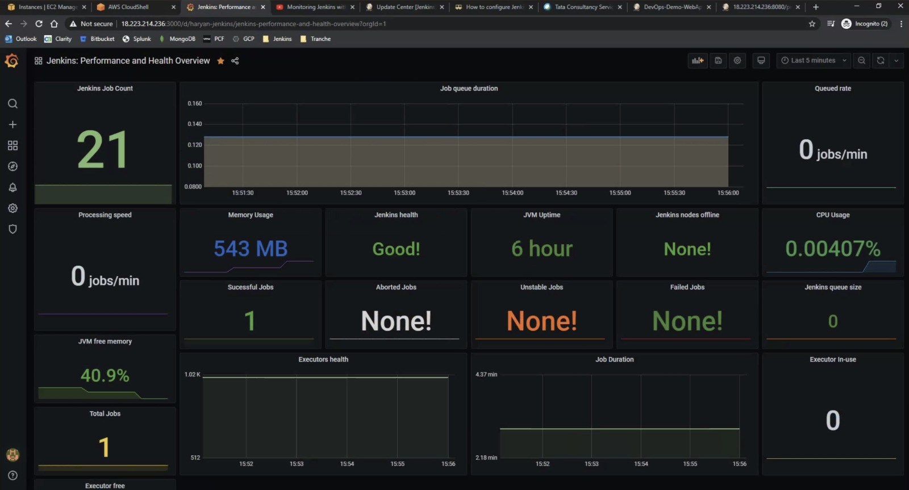
Monitoring Dashboard

Slide 14


Links
Pivotal Tracker https://www.pivotaltracker.com/n/projects/2490801
GitHub https://github.com/devopsbcsquad5/DevOps-Demo-WebApp/blob/dev-master/Jenkinsfile
Jenkins http://X.X.X.X:8080/manage (User: Jenkins | Pass: Jenkins)
SonarQube http://X.X.X.X/projects (User: sonar | Pass: sonar)
Slack https://app.slack.com/client/T01NF5WDLMQ/C01NF5WGC8J
Jfrog https://devopssquad5.jfrog.io
Blazemeter https://a.blazemeter.com/app/#/accounts/766548/workspaces/775624/dashboard
Test Server http://X.X.X.X:8080/QAWebapp/ (User: tomcat| Pass: tomcat)
Prod Server http://X.X.X.X:8080/ProdWebapp/ (User: tomcat| Pass: tomcat)

Slide 15
